Slide 1

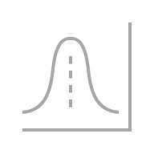

probability of photon moving s→a
0.11
c
c
a
a
…
s
0.1
d
d
0.2
s
b
b
0.15
e
e
probability of photon moving b→e
The physical layout of a double slit experiment. Photons from a flashlight (s) can go through slits (a, or b) and then to one of three photon detectors (c, d, or e).
A simplified view of the paths that particles can take from the start (s) to a detector (c, d, or e).

